Slide 1
MASTERSLAVE J K FLIPFLOP
The Master-Slave Flip-Flop is basically a combination of two JK flip-flops connected in a series configuration. Out of these, one acts as the “master” and the other as a “slave”. The output from the master flip flop is connected to the two inputs of the slave flip flop whose output is fed back to inputs of the master flip flop .
The inverter is connected to clock pulse in such a way that the inverted clock pulse is given to the slave flip-flop. In other words, if CP=0 for a master flip-flop, then CP=1 for a slave flip-flop and if CP=1 for master flip flop then it becomes 0 for slave flip flop.

Slide 2
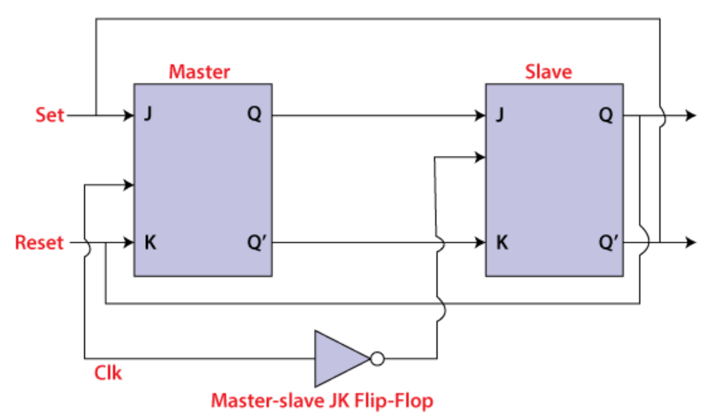
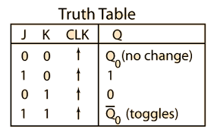
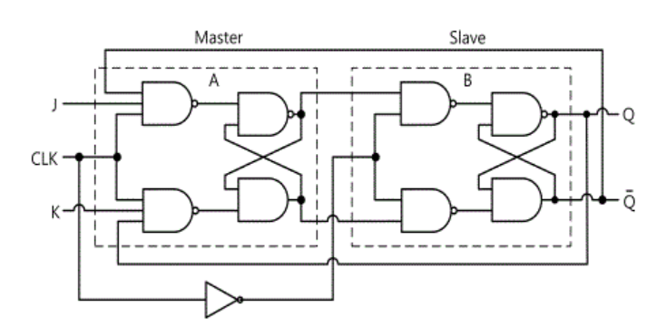
Q(t)
Q(t)’

Slide 3
MASTERSLAVE J K FLIPFLOP - working
When the clock pulse is true, the slave flip flop will be in the isolated state, and the system's state may be affected by the J and K inputs. The "slave" remains isolated until the CP is 1. When the CP set to 0, the master flip-flop passes the information to the slave flip flop to obtain the output.
The master flip flop responds first from the slave because the master flip flop is the positive level trigger, and the slave flip flop is the negative level trigger.
The output Q'=1 of the master flip flop is passed to the slave flip flop as an input K when the input J set to 0 and K set to 1. The clock forces the slave flip flop to work as reset, and then the slave copies the master flip flop.

Slide 4
MASTERSLAVE J K FLIPFLOP - working
When J=1, and K=0, the output Q=1 is passed to the J input of the slave. The clock's negative transition sets the slave and copies the master.
The master flip flop toggles on the clock's positive transition when the inputs J and K set to 1. At that time, the slave flip flop toggles on the clock's negative transition.
The flip flop will be disabled, and Q remains unchanged when both the inputs of the JK flip flop set to 0.

Slide 5
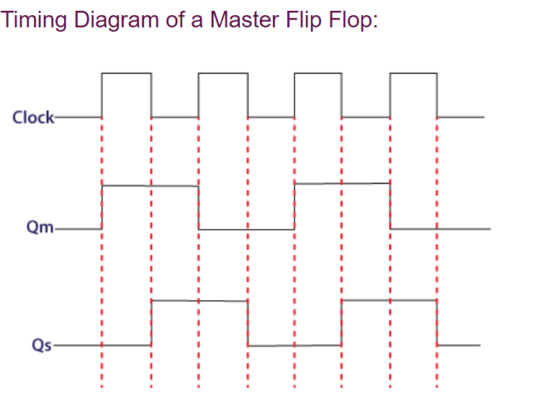

Slide 6
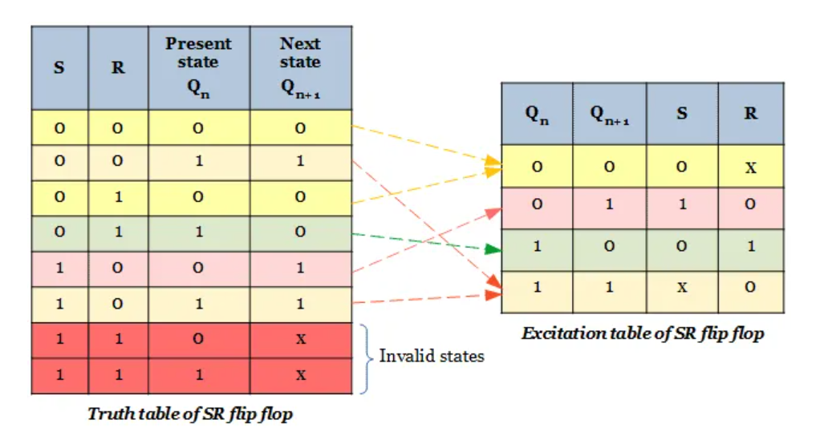
CHARATERISTIC TABLE & EXCITATION TABLE
SR flip flop
S | R | Q | Q’
0 | 0 | Hold previous | Hold previous
0 | 1 | 0 | 1
1 | 0 | 1 | 0
1 | 1 | invalid | invalid
Characteristics table

Slide 7
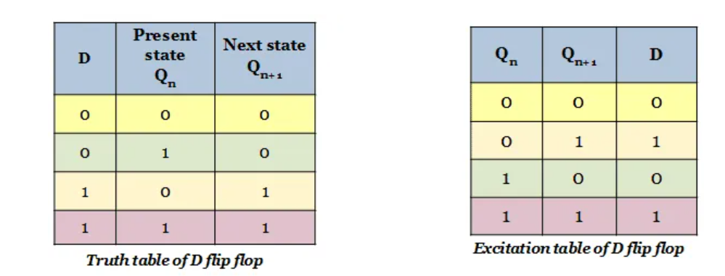
D flip flop
Q(t) | D | Q(t+1)
0 | 0 | 0
0 | 1 | 1
1 | 0 | 0
1 | 1 | 1
Characteristics table

Slide 8
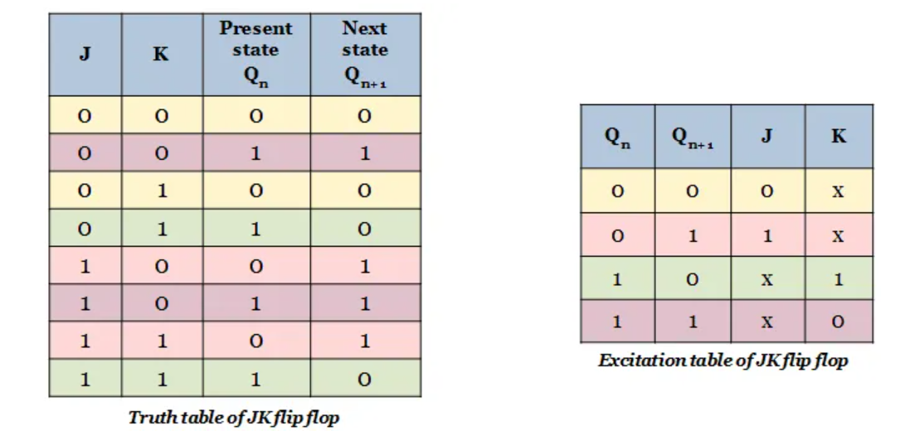
JK flip flop
Charateristic table

Slide 9
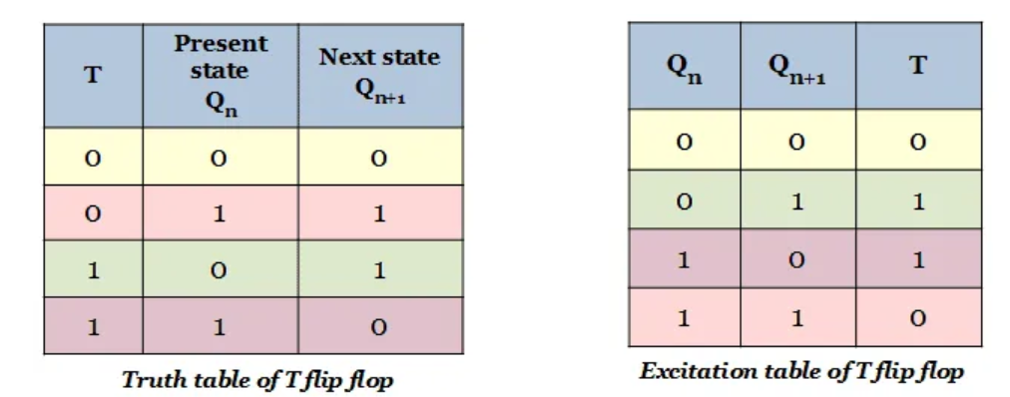
T flip flop
Q(t) | T | Q(t+1)
0 | 0 | 0
1 | 0 | 1
0 | 1 | 1
1 | 1 | 0
Truth table
Characteristics table

